Slide 1


Community Exchange
Amaya Bryant and Julianna Truitt
9/17/2024
https://youtu.be/UOg6nNX4oYg

Slide 2
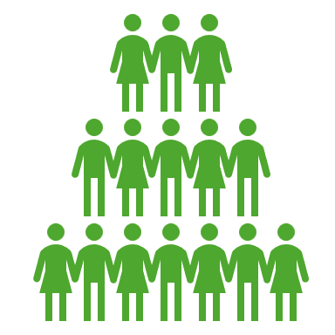



Need
Today's society is very individualistic and "hustle culture" is at an all-time high.
People need a more affordable alternative to traditional businesses for home services or personal tasks.
People often struggle to find reliable, skilled workers for odd jobs and tasks.
Many people have valuable skills but may not know how to monetize or use them effectively in their community.

Slide 3




Desire
People enjoy being part of a community where they can give and receive help.
Users desire to feel more self-reliant and resourceful, without always depending on paid services.
Many users, particularly eco-conscious or budget-conscious people, will be attracted by the idea of resourcefulness.
Users like the idea of variety and choice in the types of services they can offer or request.

Slide 4

User Profile
Demographics
Age: 18-55
Gender: all
Lifestyle & Attitude
Employed & freelance individuals
People with flexible schedules or remote work
Likes to learn
Involved in their community
Resourceful
Likes schedules and stability
Enjoys DIYs & learning
Attributes
Intelligent
Social
Tech-Savvy
Needs
Practicality
Financial (save money by exchanging services)
Convenience (easy access to local help)
Family & Environment
Urban
Suburban
Low/Middle class

Slide 5
Existing Systems
TaskRabbit
Hire others to do services for you (home repairs, moving assistance)
Nextdoor
Connect with community and share recommendations
Craigslist
Ads website- services, items for sale, jobs
Fiverr
Freelancers offering services to clients

Slide 6
Golden Pitch (why, how, what)
Why:
Today's world is face-paced and individualistic. Many people are seeking for meaningful ways to connect with people around them. We want to foster a collaborative environment to help individuals build stronger community relationships. As more people interact more with their neighbors, they will create bonds that contribute to a safer community.
How:
We connect users based on their skills and needs, allowing them to trade services directly. Whether you need help with plumbing, organizing, childcare, or tech support, you can find someone nearby willing to assist. In return, you offer your own skills in areas where you excel. Through verified profiles, reviews, and a secure platform, we ensure that users feel confident and safe in every exchange. It's simple: you list what you can do, browse services you need, and make a fair trade—all in one intuitive app.
What:
Our platform is a service-exchange marketplace that allows users to trade skills and time instead of money. It’s a flexible, affordable, and community-driven solution to everyday tasks and challenges.

Slide 7
Solution: Community Exchange
Service exchange app
Create a profile/sign
List skills user can offer
Browse/post needs
Match and trade
Agree on terms
Complete services
Leave reviews on user
Builds credibility and trust

Slide 8

Features & Benefits
Features
Skill Discovery & Recommendation
Suggest skills based on user profiles, interests, and activities
Community Events and Workshops
Option for organizing a larger event in a common area
Benefits
Strengthens Communities
As people start interacting with their neighbor more, we can get to know each other and build a stronger/safer community

Slide 9
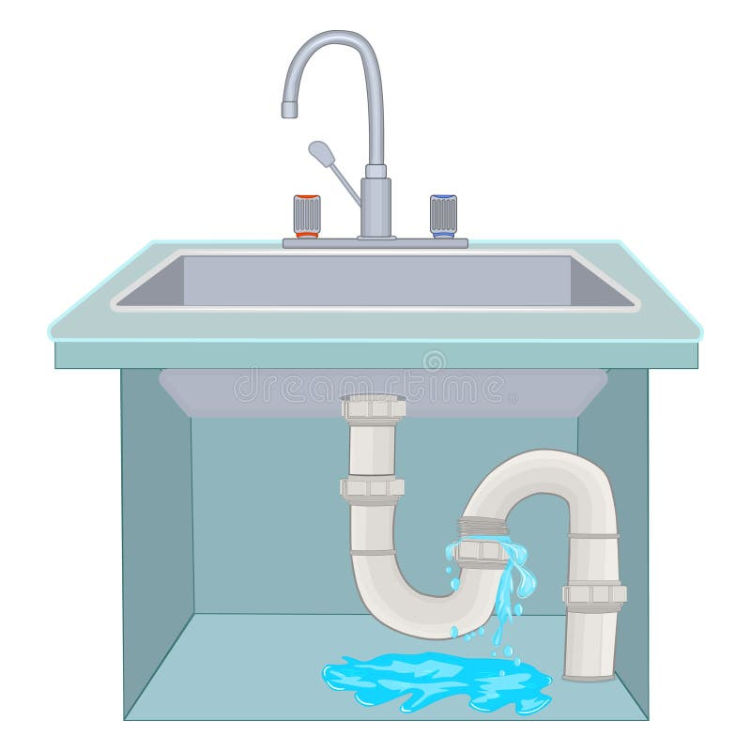
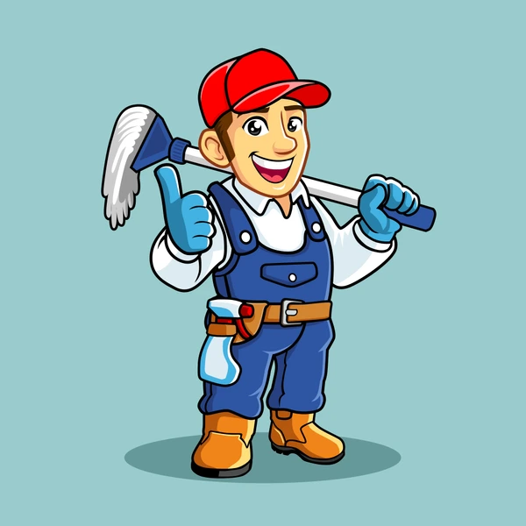
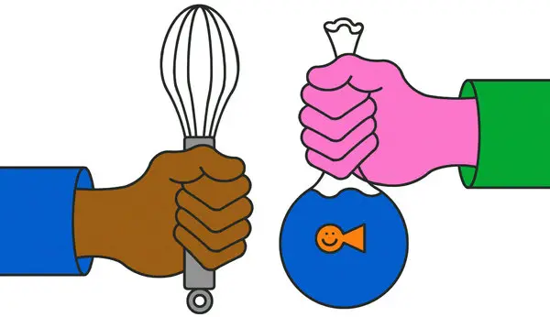



Analogy
Like a dating app
Instead of seeking love, you seek someone with the skills you need
IMAGINE:
You need a plumber
You are a good cleaner
You find someone who knows plumbing work
You offer to deep clean their kitchen in exchange for them to fix your plumbing issue.
NO $$$$ involved

